Slide 1

Profitability Analytics Center of Excellence
Profitability Analytics
OCTOBER 20, 2020
© 2020 – Profitability Analytics Center of Excellence
Notes:
Welcome.
Intro Self
Inaugural Profitability Analytics Webinar. Discussion? This is an overview session, but we will be taking increasingly deeper dives into specific topics in future webinars.
Questions and comments using chat as I speak for 20 minutes.
Very interested in creating “Development Groups” of practitioners to further develop areas of Profitability Analytics with concepts, practices, and examples or case studies.

Slide 2
Profitability Analytics Center of Excellence
Larry White, CMA, CFM, CPA, CGFM – Executive Director, Resource Consumption Accounting Institute & Former IMA Chair, Board Member IMA
Monte Swain, PhD, CPA, CMA – Deloitte Professor of Accounting, Brigham Young University
Gary Cokins, CPIM – Founder and CEO, Analytics-Based Performance Management
Doug Hicks, CPA – President, D. T. Hicks & Co.
A network of additional collaborators
© 2020 – Profitability Analytics Center of Excellence
Notes:
This is a list of the members of PACE, and _____ are on the call today.
I might mention the IMA VP of Research, Raef Lawson, is on the call today. We keep him and Kip Krumweidde, the IMA Director of Research, closely apprised of our work.

Slide 3
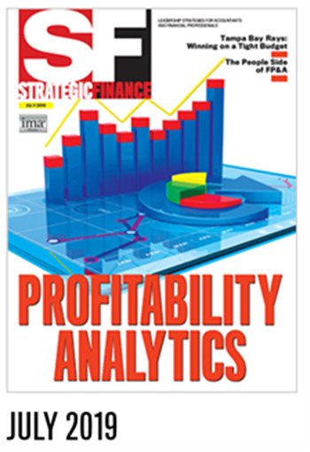
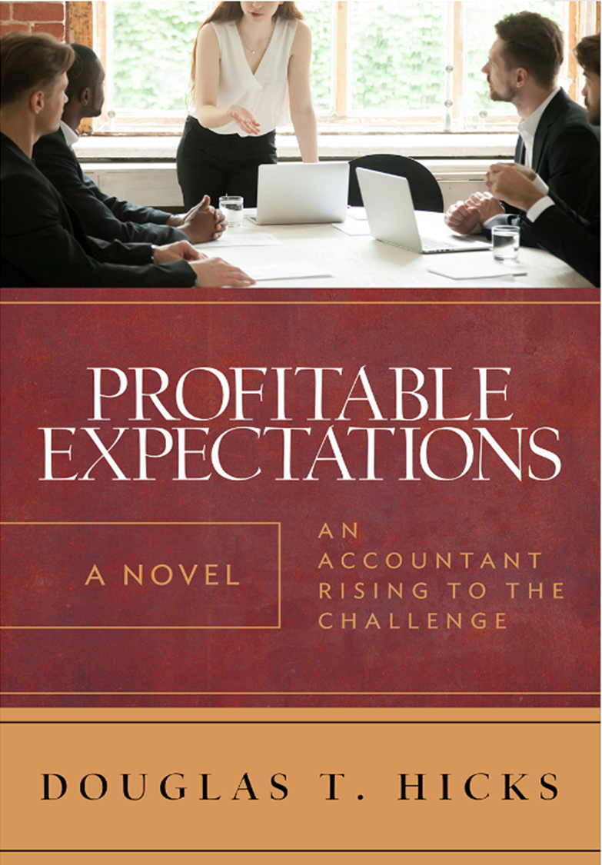

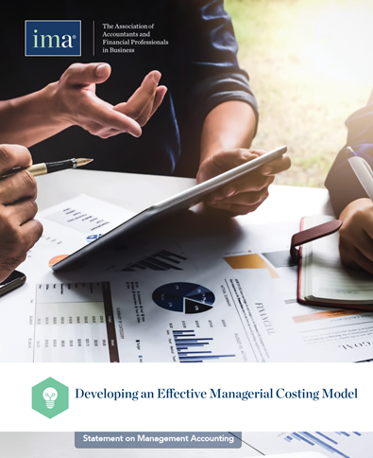

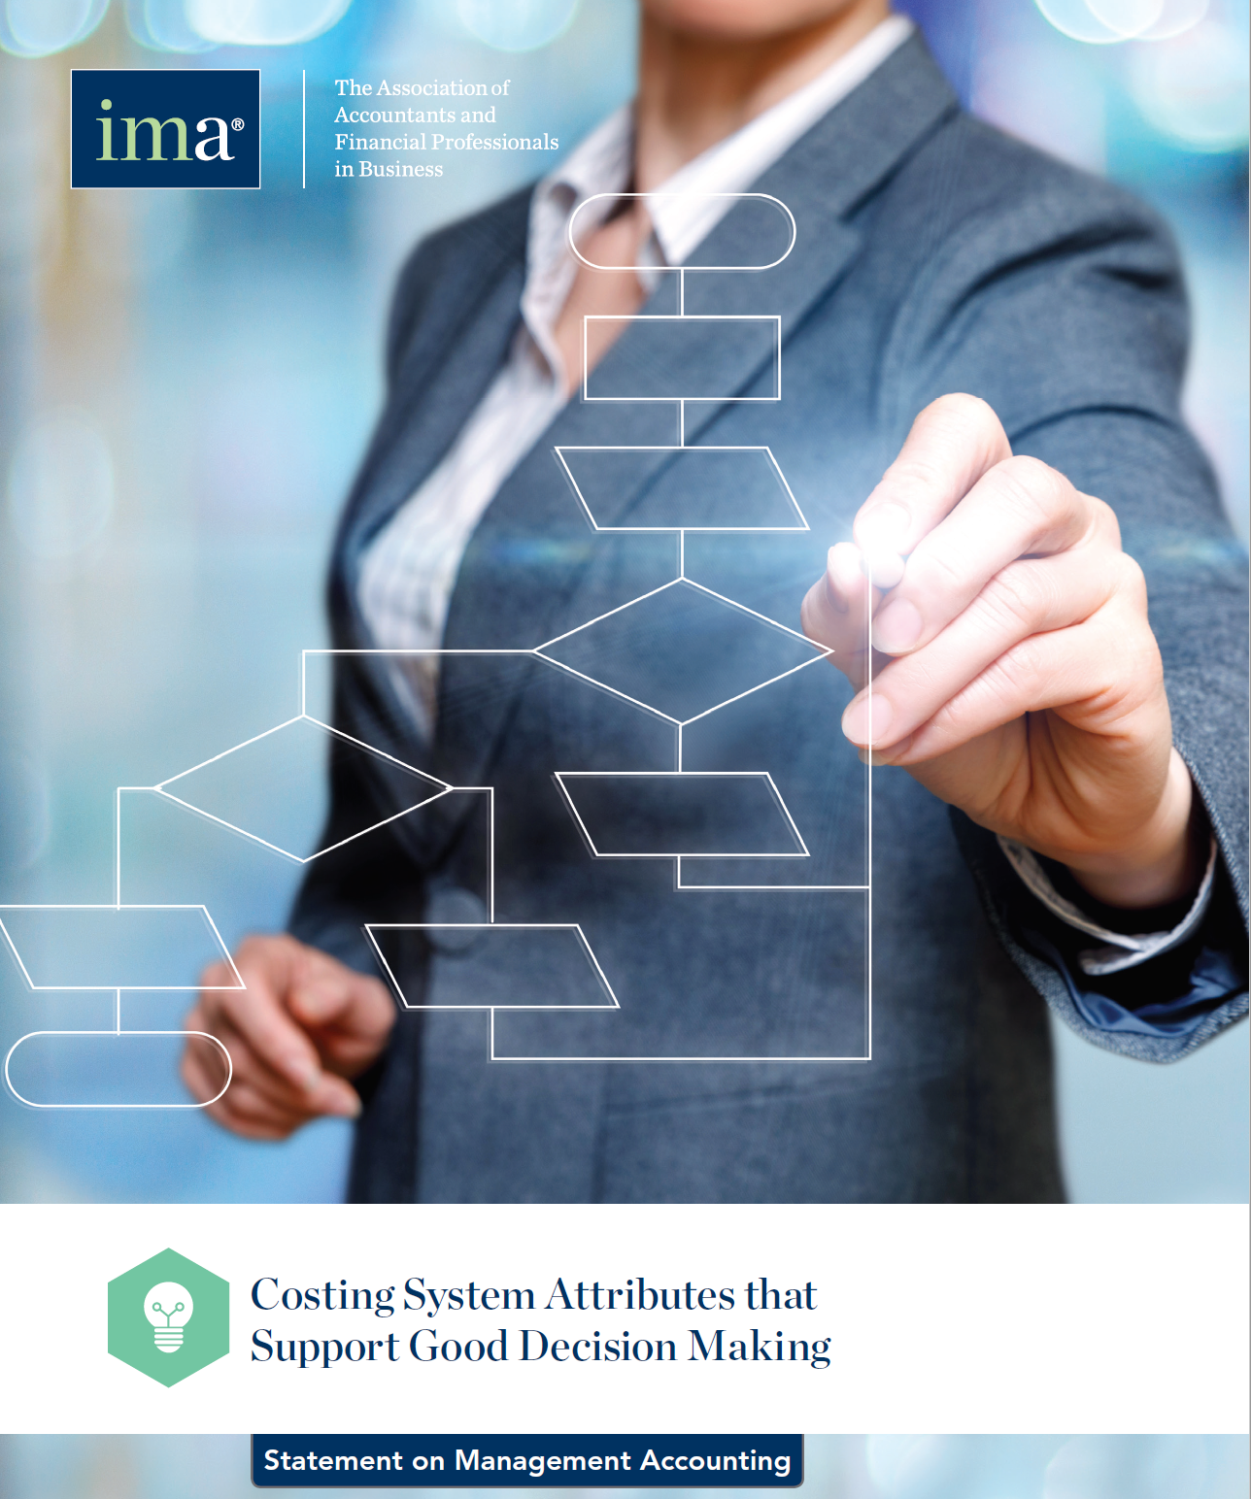
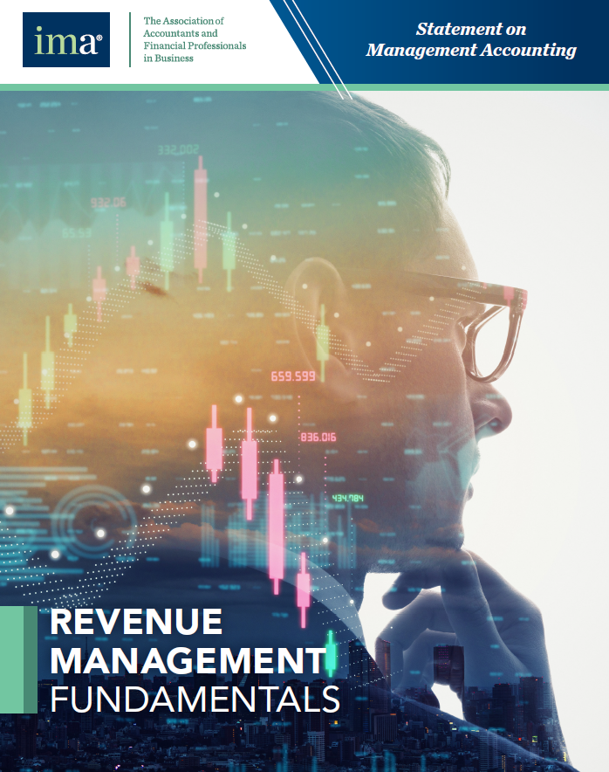
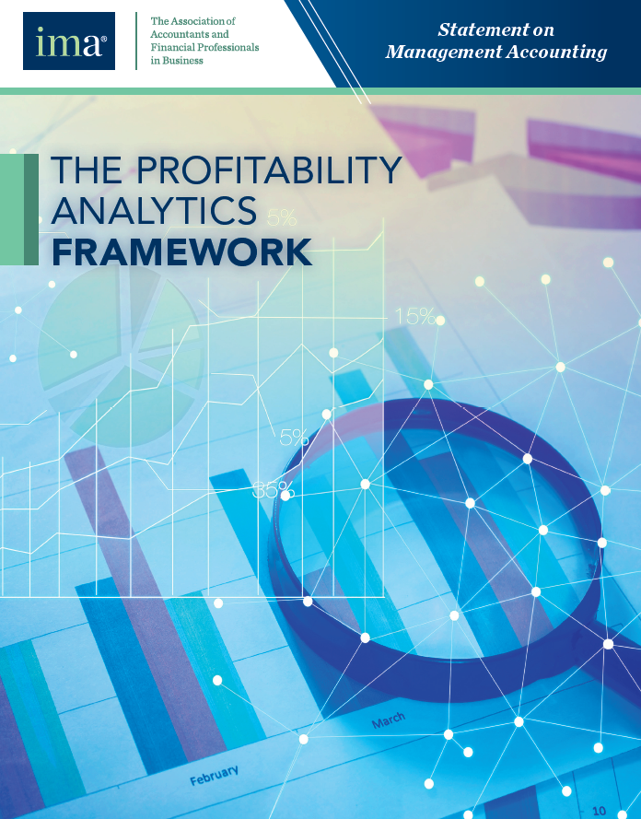
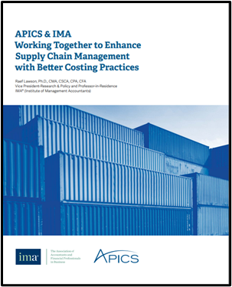
The Conceptual Framework for Managerial Costing
Notes:
These are the work products that have come out of the PACE collaboration so far.
We are not affiliated with the Institute of Management Accountants, but all of the PACE Directors are long time, dedicated IMA members and believe strongly that it is the organization that best represents and supports management accountants.

Slide 4
Profitability Analytics is the Point Where Revenue Management, Investment Management and Managerial Costing Intersect
Managerial Costing
Profitability Analytics
Revenue Management
Investment Management
© 2020 – Profitability Analytics Center of Excellence
Notes:
This simple diagram, while obvious, is the inspiration for profitability analytics and its subject matter.
The challenge is to ensure management accountants can engage throughout the organization to provide meaningful, timely, and useful internal decision support information with increasing success. This means more successfully than traditional financial reports have allowed.

Slide 5
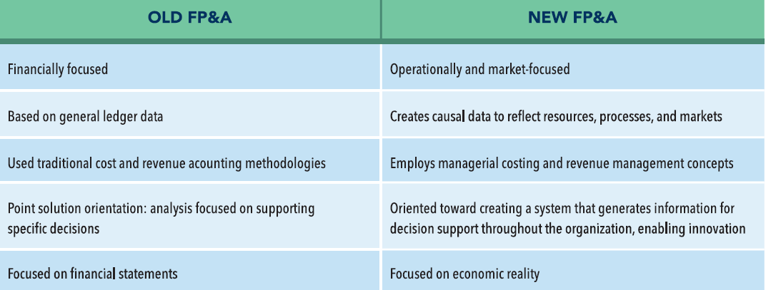
PACE™ Profitability Analytics Model
Internal Decision Support Perspective
  Scientific and Logical Principles – Causality or Cause & Effect
  Not Man-made Rules (except tax impact)
Reflect Real Economic Impact
  The Reality of Resources, Customers, Processes, Markets
Institute of Management Accountants
SMA: Profitability Analytics Framework
11/16/2020
© 2020 – Profitability Analytics Center of Excellence
Notes:
A key term for profitability analytics is Internal Decision Support.
The PA perspective focuses on Causality or cause and effect – the basis of the Scientific method and Logic. We don’t feel constrained by accounting rules, though of course, tax rules do matter.
The focus is on Real Economic Impact – the realities of resources, customers, processes, and markets.
Financial Planning and Analysis functions are the area of many organizations that execute the functions related to profitability analytics. The chart at the bottom shows some substantial differences between typical FP&A and the FP&A Function supported by PA.

Slide 6
PACE™ Profitability Analytics Model
Formulate
the Strategy
Quantify
the Strategy
Execute
the Strategy
The Three Factors of ROI
Revenue Management
The Three Stages of Strategy Planning
Managerial Costing
Investment Management
© 2020 – Profitability Analytics Center of Excellence
Notes:
The PA model incorporates:
The traditional elements of ROI, but not necessarily in a traditional way.
The organizational strategic planning process because it is a critical engagement point across the entire organization.
PACE adopts the IMA view that traditional accounting work will diminish as technology takes over routine and rule driven activities. PA seeks to set a new framework for management accountants to engage across the organization to create information and insights for long term value creation.

Slide 7
PACE™ Profitability Analytics Model
Strategy Validation
(Causal Models)
Strategy Execution
(Forecasting & Decision Making)
Strategy Formulation
Market Strategy
Market Conditions
and the
Market Strategy
Revenue Model
Pricing, Capacity, Marketing, Channels, and Regulation
Revenue Mgt
Products, Services, Customers,
Channels, or SBUs
Operational Strategy
Internal Capability,
Capacity, and the
Operational Strategy
Cost Model
Based on the
IMA’s Managerial
Costing Concepts
Cost Management
Processes and
Costs
Investment Strategy
New Resources
and the
Investment Strategy
Investment Model
Sustain, Expand, Innovate, Secure,
and Comply
Investment Mgt
Tangible and
Intangible Assets
Inputs
Analytics
Results
© 2020 – Profitability Analytics Center of Excellence
Notes:
This is the Overview diagram for the Profitability Analytics Model or Framework.
The profitability analytics model consists of three elements:
Strategy
Causal Models
Decision Making
Strategy establishes the organization’s plan for identifying and addressing it’s market(s) and for mobilizing it’s resources to meet the demands anticipated.
Causal Models employ causality to model the strategy operationally in non-financial quantities, and then monetize the revenue and cost implications of the organization’s strategy. This validates or causes adaptation of the strategy.
Decision Making employs the outputs of the causal models, both operational and financial, to provide the organization’s decision makers with the accurate and relevant information they need to make economically sound decisions. Causal Information for the decisions – large and small throughout the organization –will create long term sustainable value for your Organization.

Slide 8
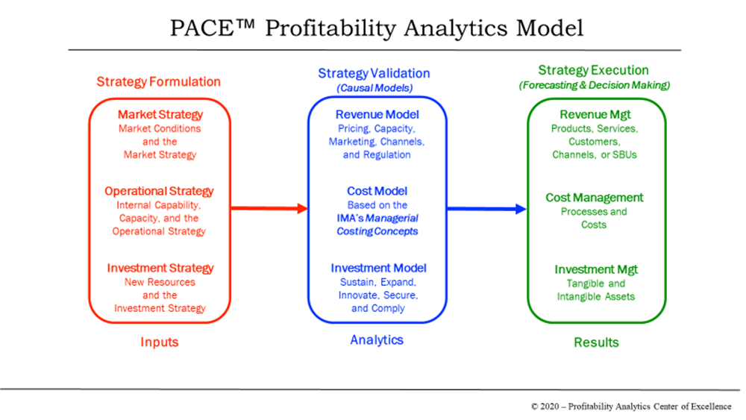
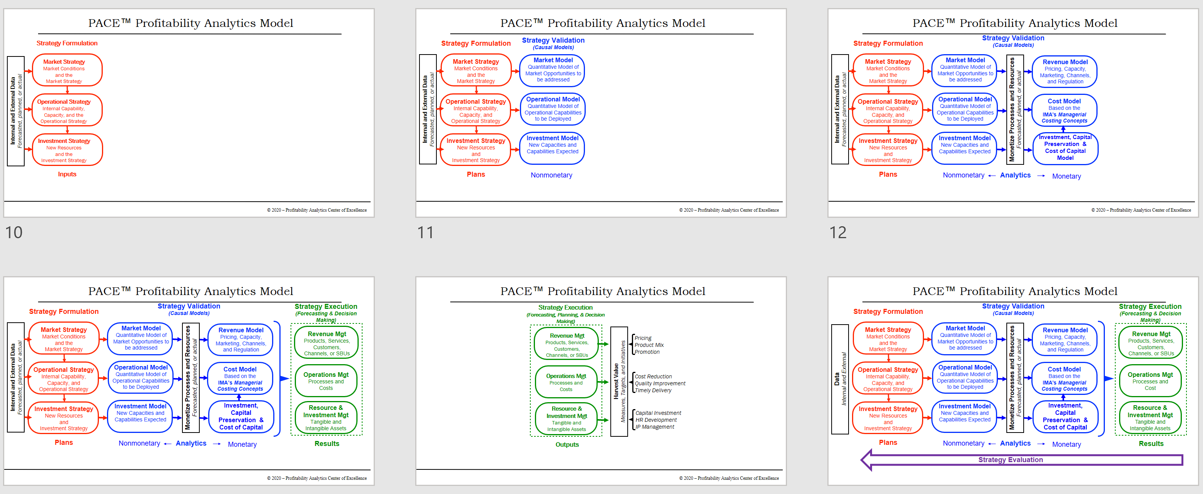
Notes:
The next few slides will decompose the high level model into its components. The PA model is not a step by step process at this point, but represents a guide to how to think about the process to ensure the result is high quality internal decision support information that management accountants to use to support decision making throughout the organization – from the C-suite to the shop floor and direct customer contact points.

Slide 9
PACE™ Profitability Analytics Model
Strategy Formulation
Market Strategy
Market Conditions
and the
Market Strategy
Operational Strategy
Internal Capability,
Capacity, and the
Operational Strategy
Internal and External Data
Forecasted, planned, or actual
Investment Strategy
New Resources
and the
Investment Strategy
Inputs
© 2020 – Profitability Analytics Center of Excellence
Notes:
Strategy Formulation
Internal and external Data are used to guide the formulation of market, operational, and investment strategies; and the results of the market strategy provide input for the operational strategy.
A Market Strategy describes the current and expected conditions and opportunities in the market and the organization’s plan to exploit those opportunities and capture value.
An Operational Strategy describes the resources and capabilities available to the organization and how they are aligned in order to execute the market strategy.
An Investment Strategy for long term value creation may be the most important part of strategy and will likely define how far into the future the market and operational strategies must look. Investments include both tangible and intangible investments…not just traditional capital investments.

Slide 10
PACE™ Profitability Analytics Model
Strategy Formulation
Strategy Validation
(Causal Models)
Market Strategy
Market Conditions
and the
Market Strategy
Market Model
Quantitative Model of Market Opportunities to
be addressed
Operational Strategy
Internal Capability,
Capacity, and
Operational Strategy
Operational Model
Quantitative Model of
Operational Capabilities
to be Deployed
Internal and External Data
Forecasted, planned, or actual
Investment Strategy
New Resources
and
Investment Strategy
Investment Model
New Capacities and Capabilities Expected
Plans
Nonmonetary
© 2020 – Profitability Analytics Center of Excellence
Notes:
Strategy Validation - Causality is Key
Strategy is a function of expected causality—internal resources and capabilities in coordination with external market forces that result in, or cause, desired outcomes. The models at this stage are non-financial primarily, and focus on the quantities, capacities, and capabilities that must be achieved.
The Market Model, based on the Market Strategy, describes the organization’s structure and processes to achieve market penetration and revenue goals. These processes involve key revenue factors including pricing tactics, capacity management, marketing campaigns, partnerships in channels, and compliance with regulations.
The Operational Model, based on the Operational Strategy, lays out the organization’s structure and processes to meet anticipated demand, achieve operational excellence, and attain logistical robustness in the supply and delivery processes.

Slide 11
PACE™ Profitability Analytics Model
Strategy Validation
(Causal Models)
Strategy Formulation
Market Strategy
Market Conditions
and the
Market Strategy
Market Model
Quantitative Model of Market Opportunities to
be addressed
Revenue Model
Pricing, Capacity, Marketing, Channels, and Regulation
Operational Strategy
Internal Capability,
Capacity, and
Operational Strategy
Operational Model
Quantitative Model of
Operational Capabilities
to be Deployed
Cost Model
Based on the
IMA’s Managerial
Costing Concepts
Internal and External Data
Forecasted, planned, or actual
Monetize Processes and Resources
Forecasted, planned, or actual
Investment Strategy
New Resources
and
Investment Strategy
Investment Model
New Capacities and Capabilities Expected
Investment, Capital Preservation & Cost of Capital Model
Plans
Nonmonetary
Analytics
Monetary
© 2020 – Profitability Analytics Center of Excellence
Notes:
Causality: Monetary Models must Reflect Quantitative Planning
Models must first be build using non-financial quantities, then monetized in a manner that reflects those quantities and supports decision making.
The Revenue Model incorporates the pricing and volume assumptions.
The Cost Model monetizes the cost of the resources and processes for decision making and operational optimization. Both operational and cost models reflect the functioning of the entire organization; they do not fixate on product and service costs.
Investment at this stage becomes 3 distinct components: Acquisition – How to acquire or create new capability with financial or internal resources? Capital Preservation: How to ensure the capability being consumed can be maintained into the future? Applies to tangible and intangible assets Cost of Capital: How to ensure long term investments are yielding a return that factors in the capital outlay?
Monetization of Processes and Resources should reflect forward-looking economic costs and not be limited to costs and expenses as defined and measured by financial accounting principles.
Key economic causality concepts, explained in the IMA’s Conceptual Framework for Managerial Costing, are essential to building a model that effectively represents actual cost flows in the organization.

Slide 12
PACE™ Profitability Analytics Model
Strategy Validation
(Causal Models)
Strategy Execution
(Forecasting & Decision Making)
Strategy Formulation
Market Strategy
Market Conditions
and the
Market Strategy
Market Model
Quantitative Model of Market Opportunities to
be addressed
Revenue Model
Pricing, Capacity, Marketing, Channels, and Regulation
Revenue Mgt
Products, Services, Customers,
Channels, or SBUs
Operational Strategy
Internal Capability,
Capacity, and
Operational Strategy
Operational Model
Quantitative Model of
Operational Capabilities
to be Deployed
Cost Model
Based on the
IMA’s Managerial
Costing Concepts
Internal and External Data
Forecasted, planned, or actual
Monetize Processes and Resources
Forecasted, planned, or actual
Operations Mgt
Processes and
Costs
Investment Strategy
New Resources
and
Investment Strategy
Investment Model
New Capacities and Capabilities Expected
Investment, Capital Preservation & Cost of Capital
Resource & Investment Mgt
Tangible and
Intangible Assets
Plans
Nonmonetary
Analytics
Monetary
Results
© 2020 – Profitability Analytics Center of Excellence
Notes:
Strategy Execution
Management involves forecasting, planning, and decision-making throughout the organization. Accurate causal models that reflect economic reality are essential to effectively manage the organization towards strategic success.
Revenue management involves decisions about product or service configuration, pricing, duration control, resource and capacity assignment, and demand management for customers and channels.
Operations Management involves process management and adaptation for actual demand as well as cost, quality, and timeliness of production/service.
Resource and Investment management involves capital assets, human resources, intellectual property, R&D, and other essential tangible and intangible assets in or being acquired by the organization. Investments must have clear causal connections to strategic goals and the long term vision of the organization.
Causal monetary and operational modeling allow Strategy Execution to most effectively understand and adapt to dynamic, volatile markets.

Slide 13
PACE™ Profitability Analytics Model
Strategy Execution
(Forecasting, Planning, & Decision Making)
Revenue Mgt
Products, Services, Customers,
Channels, or SBUs
Pricing
Product Mix
Promotion
Operations Mgt
Processes and
Costs
Cost Reduction
Quality Improvement
Timely Delivery
Harvest Value
Measures, Targets, and Initiatives
Resource & Investment Mgt
Tangible and
Intangible Assets
Capital Investment
HR Development
IP Management
Outputs
© 2020 – Profitability Analytics Center of Excellence
Notes:
Harvesting Results
With Decision Making based on Causal Models that represent the Organization’s Strategy, managers can confidently establish and logically adapt performance measures.
Causal models support learning and innovation because the gap between results and projections has been established based on real cause and effect relationships. Understanding a result or a monetary effect is much clearer when you can methodically and logically trace back to an operational cause.

Slide 14
PACE™ Profitability Analytics Model
Strategy Validation
(Causal Models)
Strategy Execution
(Forecasting & Decision Making)
Strategy Formulation
Market Strategy
Market Conditions
and the
Market Strategy
Market Model
Quantitative Model of Market Opportunities to
be addressed
Revenue Model
Pricing, Capacity, Marketing, Channels, and Regulation
Revenue Mgt
Products, Services, Customers,
Channels, or SBUs
Operational Strategy
Internal Capability,
Capacity, and
Operational Strategy
Operational Model
Quantitative Model of
Operational Capabilities
to be Deployed
Cost Model
Based on the
IMA’s Managerial
Costing Concepts
Data
Internal and External
Monetize Processes and Resources
Forecasted, planned, or actual
Operations Mgt
Processes and
Cost
Investment Strategy
New Resources
and
Investment Strategy
Investment Model
New Capacities and Capabilities Expected
Investment, Capital Preservation & Cost of Capital
Resource & Investment Mgt
Tangible and
Intangible Assets
Plans
Nonmonetary
Analytics
Monetary
Results
Strategy Evaluation
Notes:
Strategy Evaluation
As decisions are made and results are realized, it is critical that management accountants assist management at all levels of the organization understand what worked as expected, better than expected, and worse than planned.
This feeds into continuous improvement, organizational learning, decisions to revise strategies and tactics, and the formulation of new strategies.

Slide 15
PACE™ Moving Forward
Profitability Analytics Field Study
Partnerships with “User/Customer” Associations
Monthly Webinar Series
PA Development Groups: (Ideas)
  Profitability
  Marketing/Revenue
  Cost Management and Modeling
  Investment Management
  FP&A Improvement
  Data Analytics
Email us with ideas and your interest in participating at:
profitabilityanalytics@gmail.com
© 2020 – Profitability Analytics Center of Excellence
Notes:
I hope I have given you an better understanding of the Profitability Analytics model. Admittedly this was high level and very fast.
PACE plans to continue use the PA Framework to push management accounting into a more prominent role as a business partner.
We are evaluating and looking for field studies – from organizations demonstrating excellence to organizations that have problems and need paths to improvement.
We want to continue to engage with “customer” professional organizations - This means customers of management accountants such as sales/marketing, manufacturing, logistics, boards of directors, etc. The questions is what more can MA do for them to improve their performance.
PACE will continue with Monthly webinars. Digging into increasing depth on PA topics.
Above all we would love to engage you in Development groups to define new ideas, refine current ideas, document and share success and even failure stories. Please email us and let us know if you would like to work on one or more of these topics in weekly or bi-weekly meetings.

Slide 16
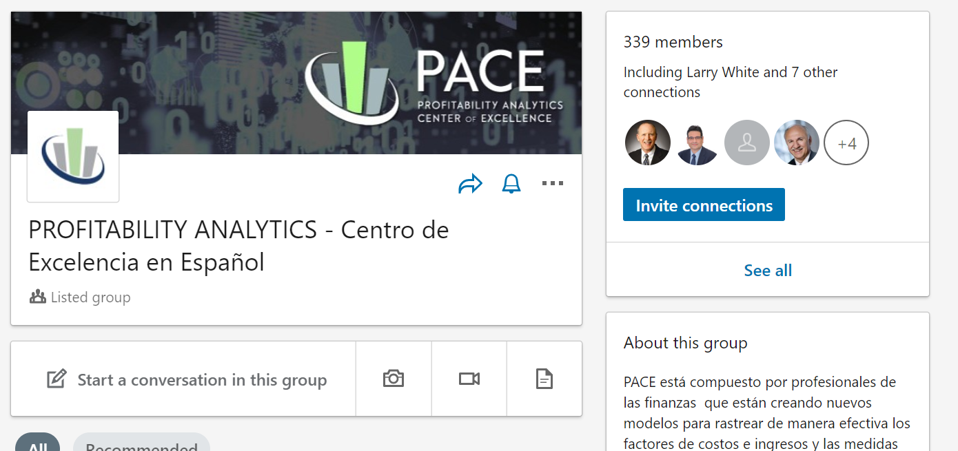
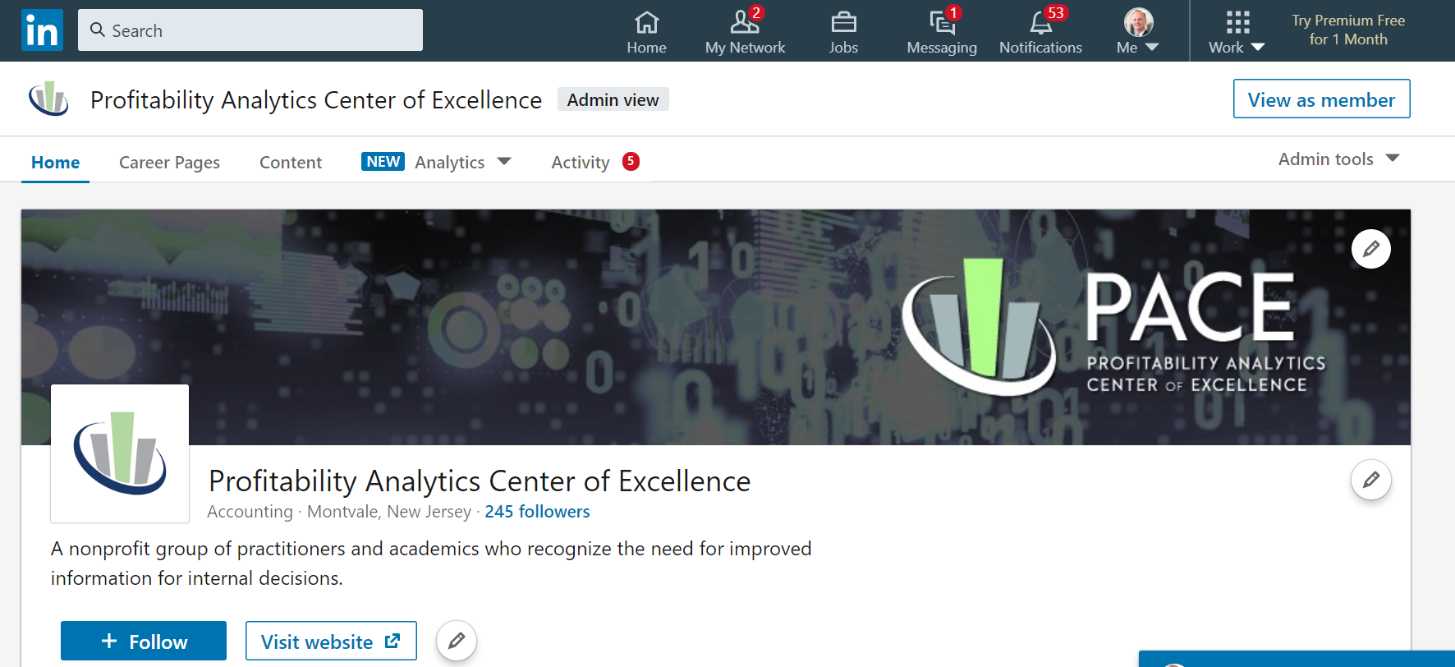
LinkedIn page
In English …
and Spanish
© 2020 – Profitability Analytics Center of Excellence
Notes:
If you are not familiar, we provide regular information on our Linked In page

Slide 17

PA Website www.profitability-analytics.org
Includes a Forum where members can exchange thoughts, experiences & best practices.
© 2020 – Profitability Analytics Center of Excellence
Notes:
And Website
The website is a repository of information and has a forum for discussion.

Slide 18

Questions?
profitabilityanalytics@gmail.com
© 2020 – Profitability Analytics Center of Excellence
Notes:
Thank you.
And now lets look at your questions and comments.

